Slide 1



Course: Image Processing 31651
Assignment #12
Synthetic Image Creation (Part 2)
1
Photo of the student | Shorten Name | ID (4 last digits)
 | shienfeld | 1950 | Student #1
 | pony | 2210 | Student #2
 | akimov | 7939 | Student #3

Slide 2





12.1 our resulted images “grayImage12n.bmp”
with add short comment– part 1
2
white_illusion0.bmp
In that slide we can see the process (automate process) of creating a white illution – we decided to create a total of 10 pictures in the process ( can be any number we would like)
The first image here is white_illusion0.bmp and the rest (until white_illusion9.bmp) is in the next slide

Slide 3





12.1 our resulted images “grayImage12n.bmp”
with add short comment– part 2
3
white_illusion9.bmp

Slide 4
12.1 our resulted images “grayImage12n.bmp”
with add short comment– part 3
4
white_illusion9.bmp
white_illusion0.bmp

Slide 5
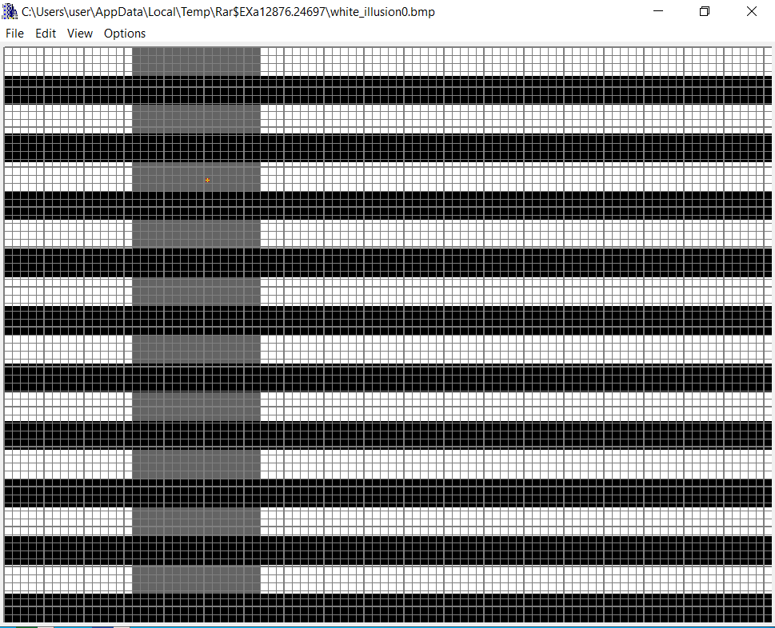
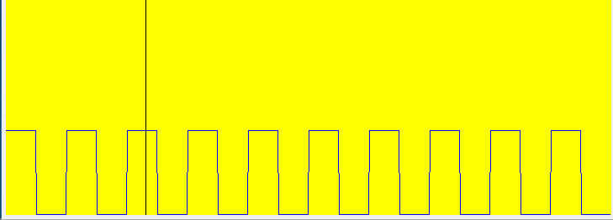
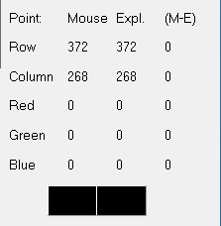
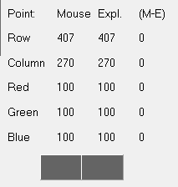
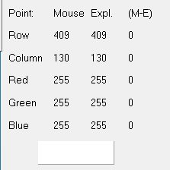
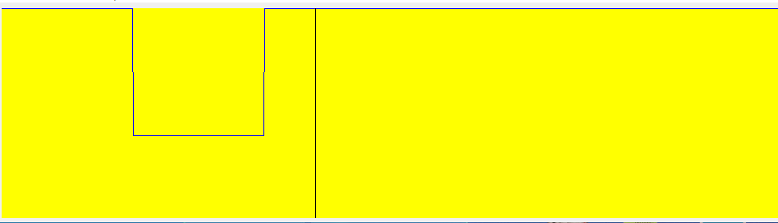
12.2 Relevant Profiles – part 1
5
white_illusion0.bmp
In the columns view ( AKA moving up and down on the same column) we can see a rectangular periodic function all over the column. That function is relevant for several columns – where we see the bold gray band!
100
0
In the rows view ( AKA moving right and left on the same row) we can see a hole function (like a potential hole).
We understand that the low level of the hole represents the bold gray band
Regarding the column view
255
100

Slide 6
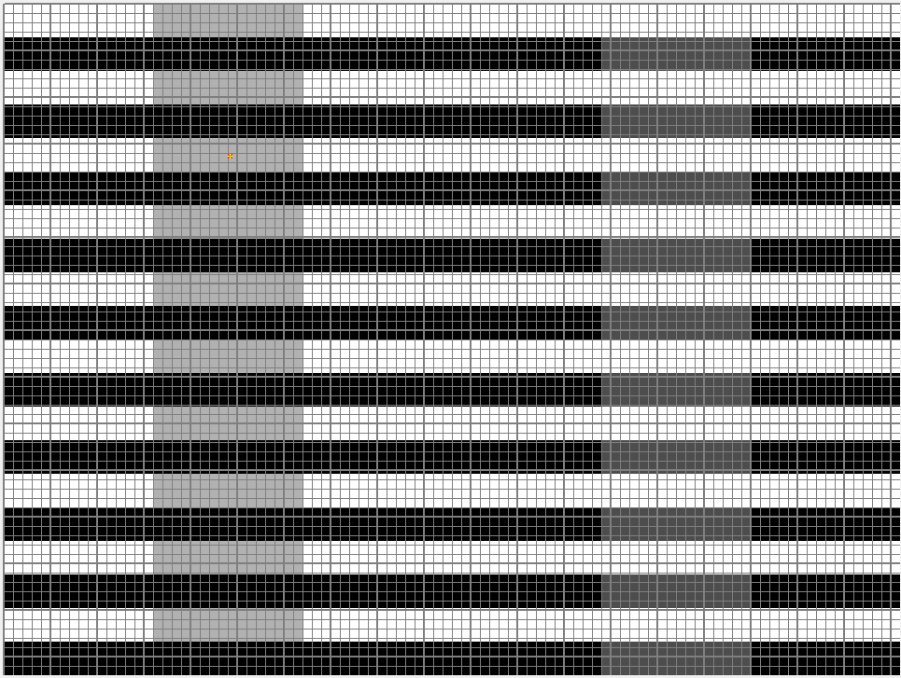
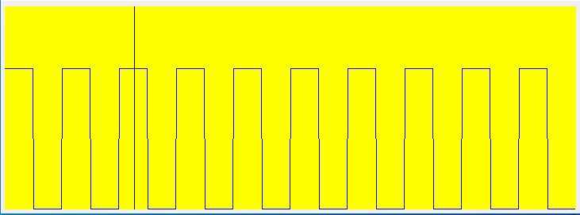
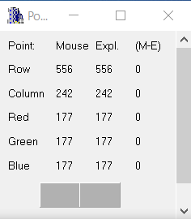
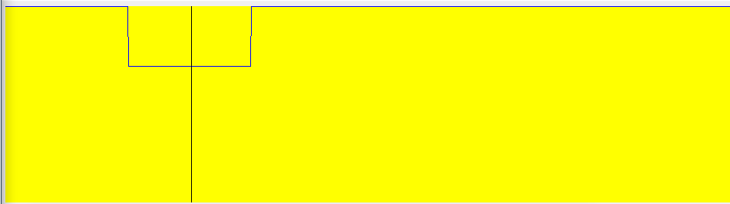
12.2 Relevant Profiles – part 2
6
white_illusion5.bmp
In the columns view ( AKA moving up and down on the same column) we can see a rectangular periodic function all over the column. That function is relevant for several columns – where we see the bold gray band!
255
0
In the rows view ( AKA moving right and left on the same row) we can see a hole function (like a potential hole).
We understand that the low level of the hole represents the bold gray band
First example from white_illusion5.bmp – another example will be presented in the next slide
255
177

Slide 7
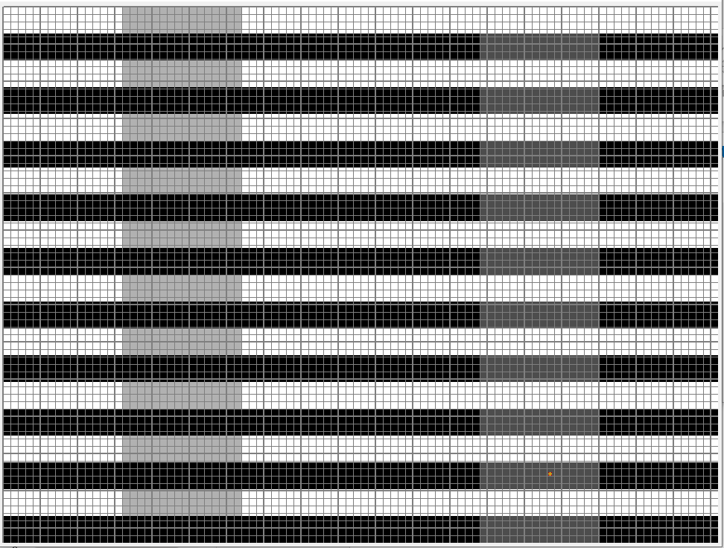
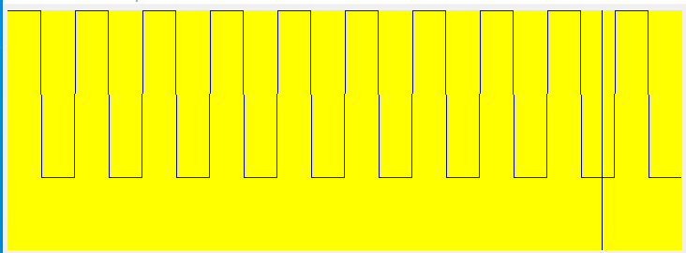
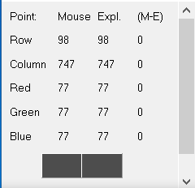
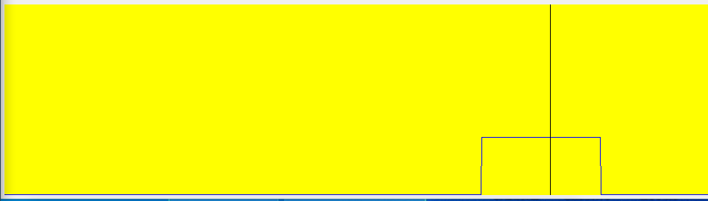
12.2 Relevant Profiles – part 3 (continue of part 2)
7
white_illusion5.bmp
In the columns view ( AKA moving up and down on the same column) we can see a rectangular periodic function all over the column. That function is relevant for several columns – where we see the bold gray band!
255 (column)
77 (column)
77
255
In the rows view ( AKA moving right and left on the same row) we can see a step function.
77 (row)
77

Slide 8
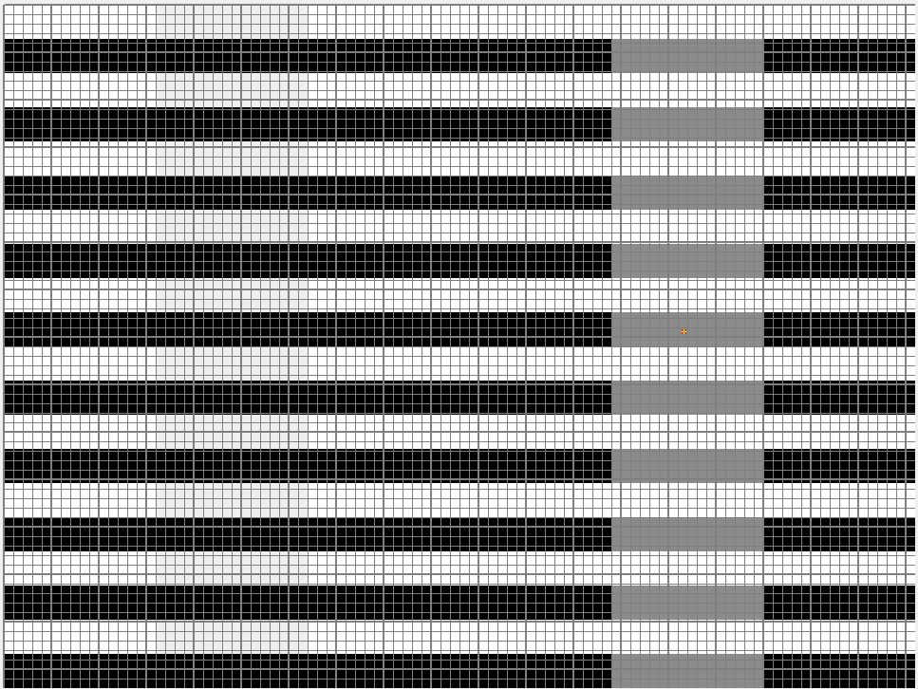
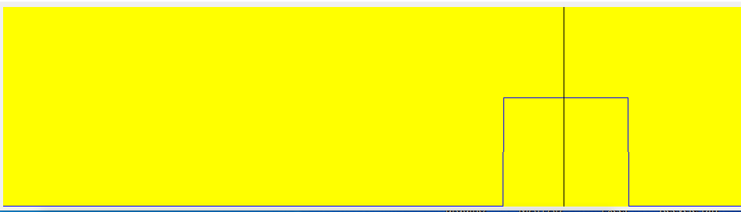
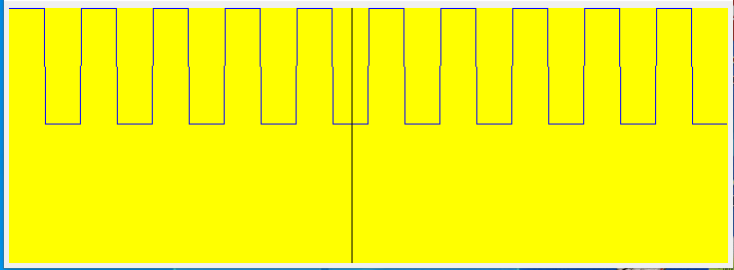
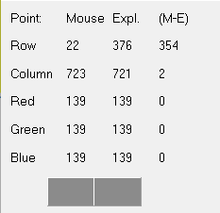
12.2 Relevant Profiles – part 4
8
white_illusion9.bmp
In the rows view ( AKA moving right and left on the same row) we can see a step function.
We understand that the low level of the hole represents the non bold gray band
139
0
255
139
In the columns view ( AKA moving up and down on the same column) we can see a rectangular periodic function all over the column. That function is relevant for several columns – where we see the bold gray band!

Slide 9
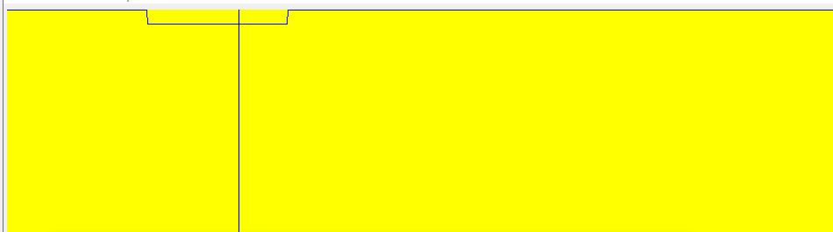
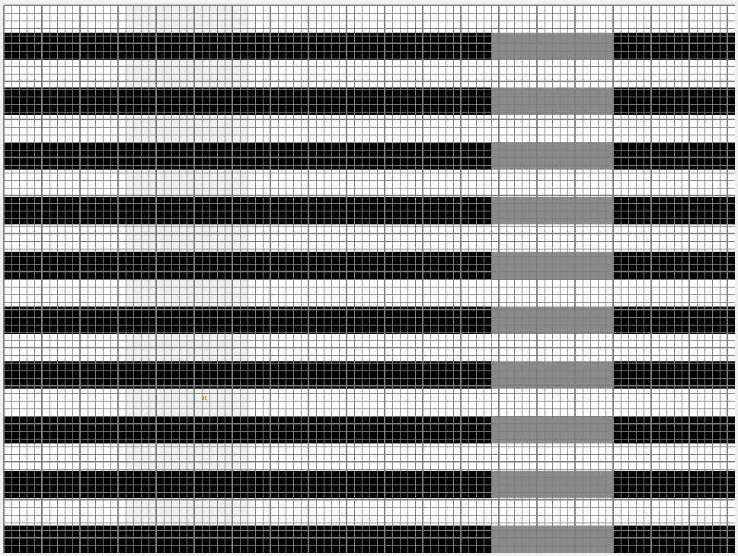
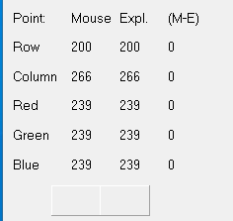
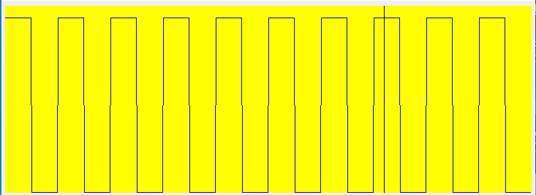
12.2 Relevant Profiles – part 5 (continue of part 4)
9
white_illusion9.bmp
Rows view
239
255
239
0
In the rows view ( AKA moving right and left on the same row) we can see a very delicate hole function.
We understand that the very low level of the hole represents the non bold gray band (almost white = 239 ~255)

Slide 10
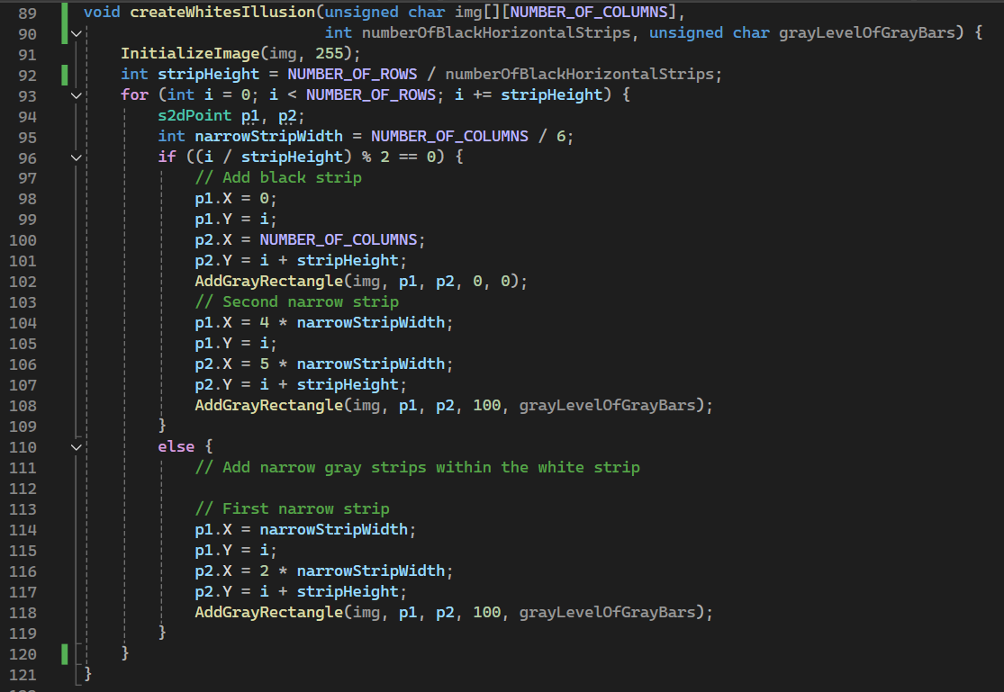
12.3 Code of the function “createWhitesIllusion” – part 1
10
The function createWhitesIllusion is designed to create an illusion pattern on a grayscale image by adding alternating black and gray strips to a white background.
First input parameter : unsigned char img [] [NUMBER_OF_COLUMNS]:
A 2D array representing the image where the illusion will be created.
Second input parameter : int numberOfBlackHorizontalStrips:
The number of black horizontal strips to be added to the image.
third input parameter : unsigned char grayLevelOfGrayBars:
The gray level of the gray bars that will be added within the white strips.

Slide 11
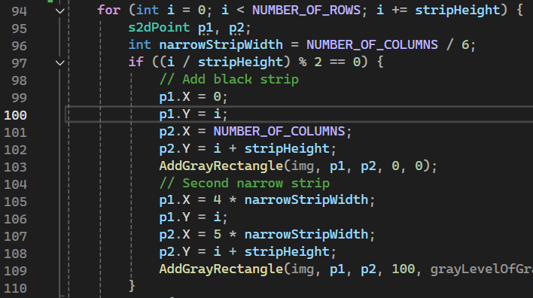
12.3 Code of the function “createWhitesIllusion” – part 2
11
The image is initialized to a white background (gray level 255).
The height of each strip is calculated by dividing the total number of rows by the number of black horizontal strips.
The for loop iterates through the image rows in steps of stripHeight to add alternating strips.
For even-indexed strips (if ((i / stripHeight) % 2 == 0)), add a black strip and a narrow gray strip:

Slide 12
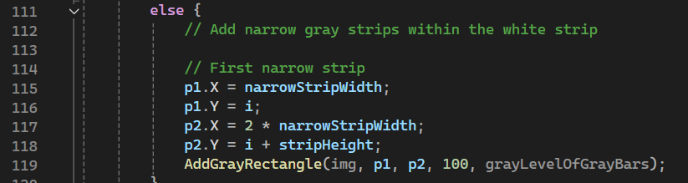
12.3 Code of the function “createWhitesIllusion” – part 3
12
For odd-indexed strips (else) , add a narrow gray strip within the white strip
The function AddGrayRectangle is called to add rectangles with specified transparency and gray levels.
It first validates the coordinates using checkValidation, then applies the rectangle with blending techniques.
Final conclusion : the createWhitesIllusion function creates an illusion on a grayscale image by alternating black and gray strips on a white background. Even rows are filled with black strips, including a narrow gray strip, while odd rows only contain narrow gray strips. This pattern is generated using loops and helper functions to manipulate the pixel values of the image array.

Slide 13
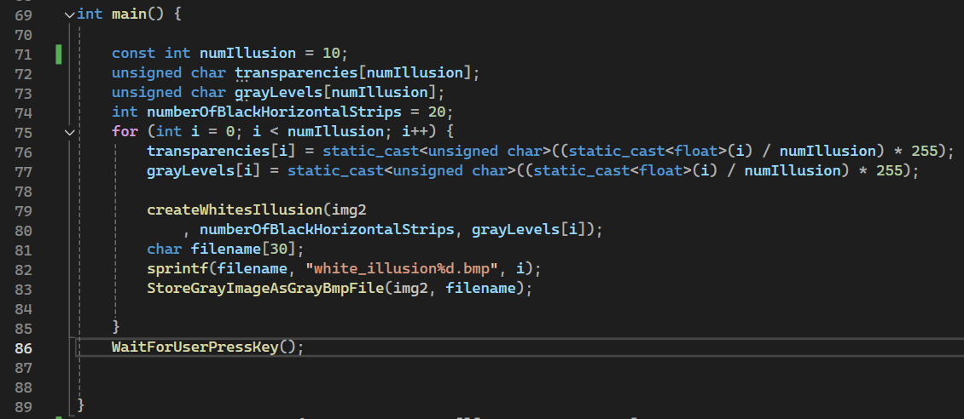
12.4 Code of the main function – part 1
13
The main function in the provided code is responsible for setting up and creating multiple versions of a visual illusion pattern, saving each version as a BMP file.
Transparency and gray level values are calculated based on the iteration index i, resulting in a range of values from 0 to 255.
The createWhitesIllusion function is called to create the illusion pattern on the img2 array using the calculated gray level.
The main function initializes arrays for transparency and gray levels and then iterates to create multiple illusion images with varying gray levels
Each generated image is saved as a BMP file with a unique name.
Finally, the program waits for user input to ensure the user has a chance to review the output before the program finishes execution.

Slide 14
12.5 What did we learned ?
14
understand how grayscale images are represented and manipulated, using values from 0 (black) to 255 (white).
Learn how to blend different transparency levels and gray levels to create visual effects.
Apply geometric concepts to determine the positions and dimensions of shapes within an image.
Understand techniques for generating dynamic filenames to save multiple output files.

